Slide 1

Quotes presentation
by
Infogro Technology
These is nothing like home. Live the life with smile. Positive thinking positive result.

Slide 2
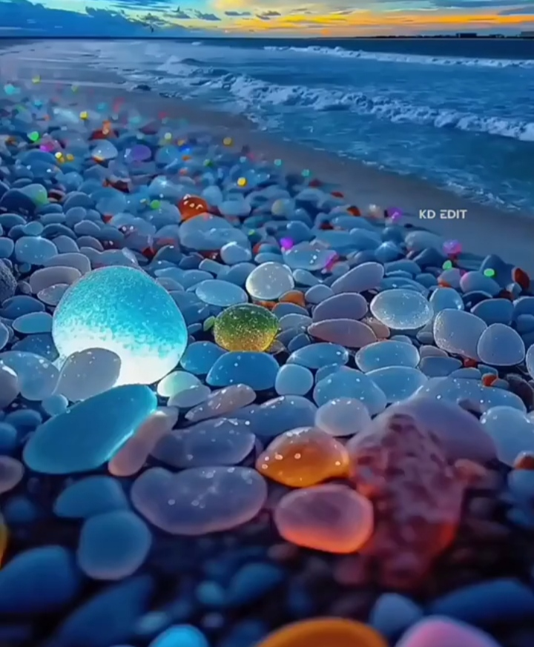

Slide 3


Slide 5


Slide 6


Slide 7


Slide 8


Slide 9


Slide 10
The End

